Slide 1


Slide 2
1. How Many Cases of Coronavirus Will There Be in Your Area?

Slide 3
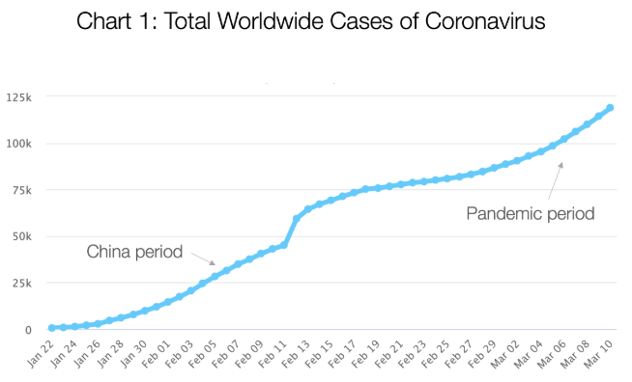

Slide 10
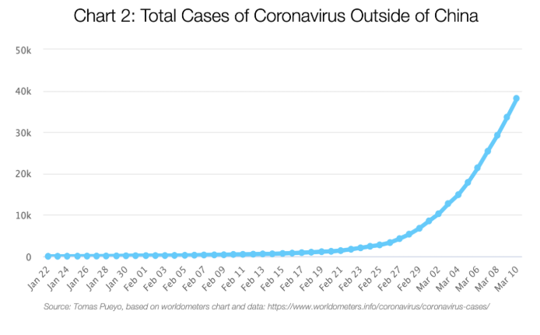

Slide 12
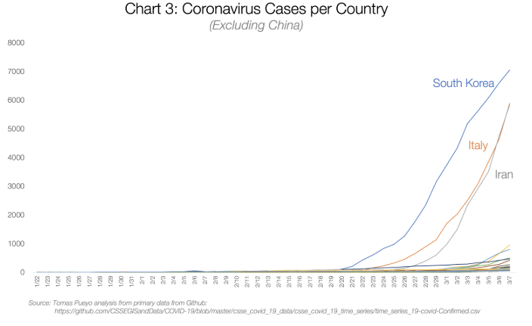

Slide 15
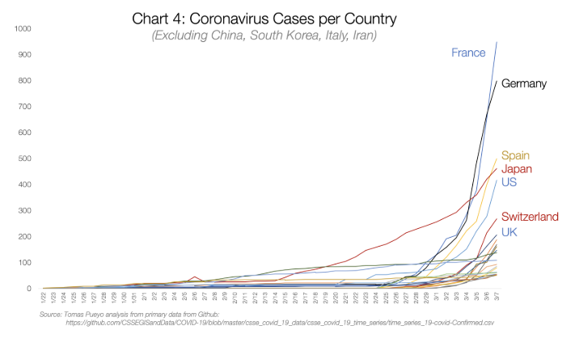

Slide 17
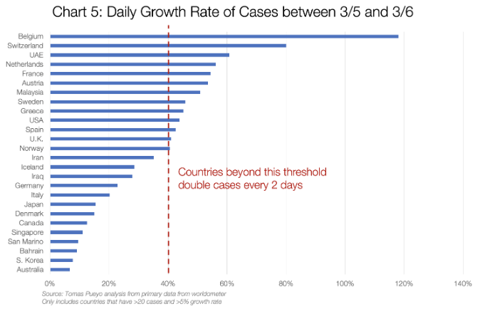

Slide 18
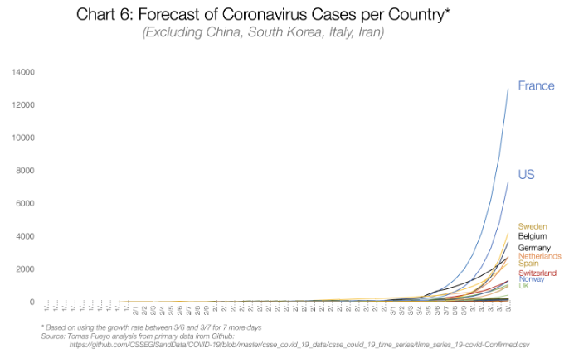

Slide 19
China

Slide 20
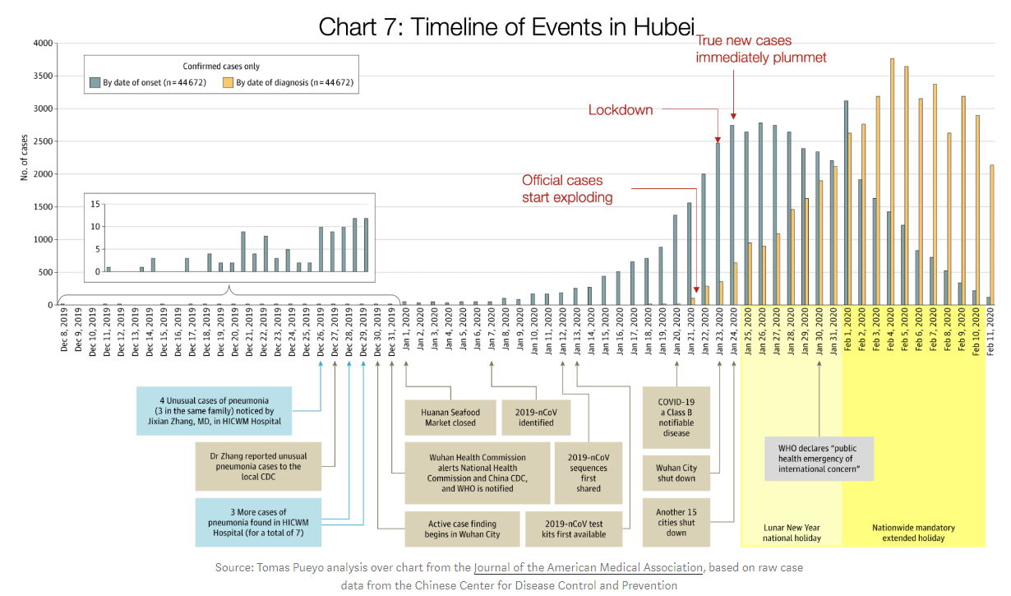

Slide 22


Slide 23
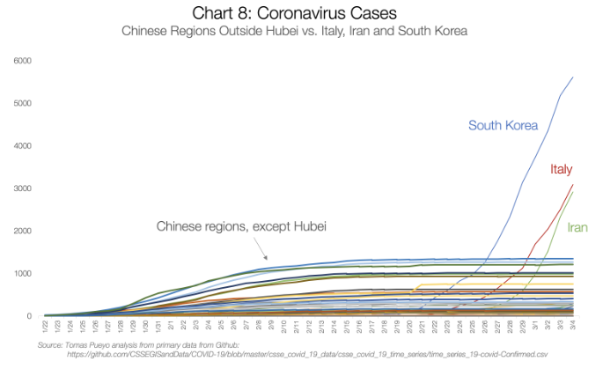

Slide 24
Eastern Countries

Slide 25
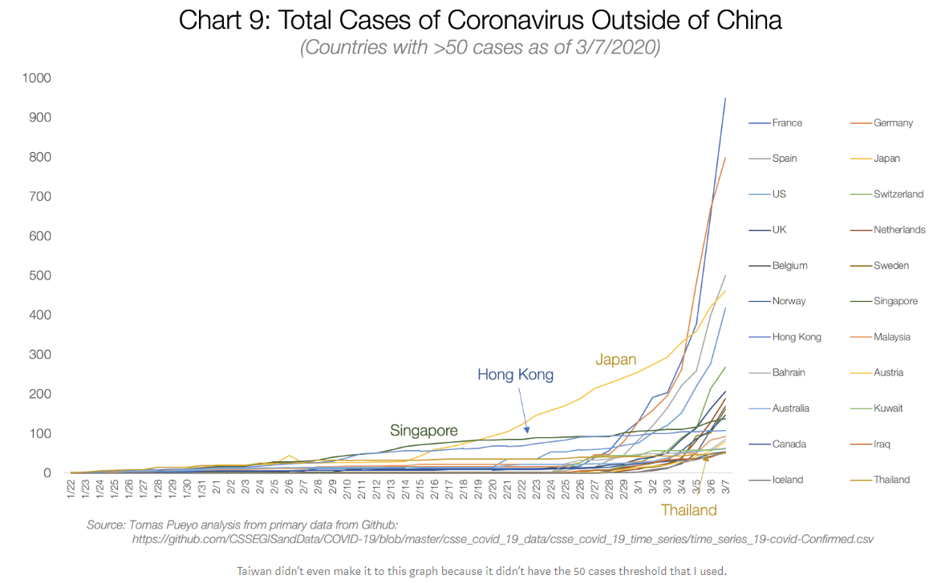

Slide 26
Washington State

Slide 27
San Francisco Bay Area

Slide 28
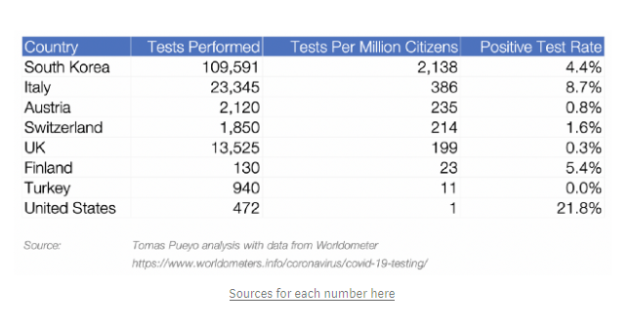

Slide 29
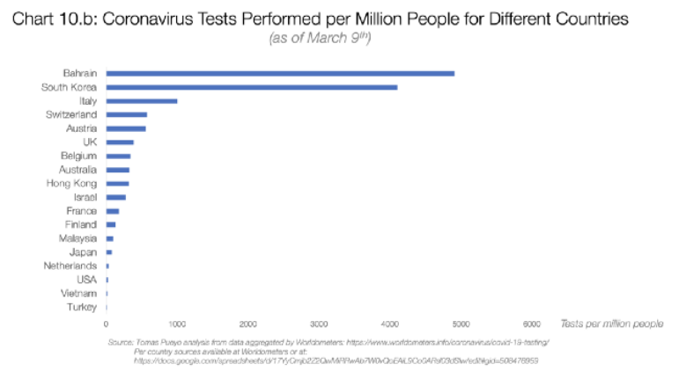

Slide 30
Francia, España y Madrid.

